Slide 1
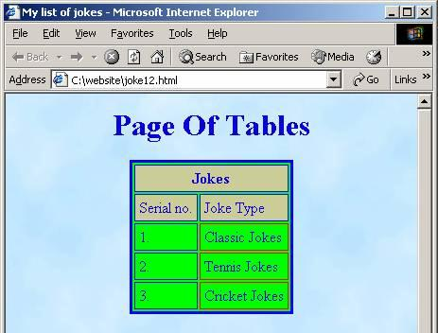
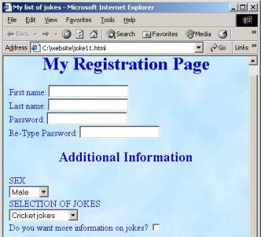

HTML – Tables and Forms
Svetlin Nakov
Telerik Corporation
www.telerik.com

Slide 2

Contents
HTML Tables
Nested Tables
Cells Width
Cell Spacing and Padding
Column and Row Span

Slide 3


Contents (2)
HTML Forms
Form Fields and Fieldsets
Form Controls and Labels
Text field
Text area
Select
Radio button
Checkbox
Button
Image button

Slide 4
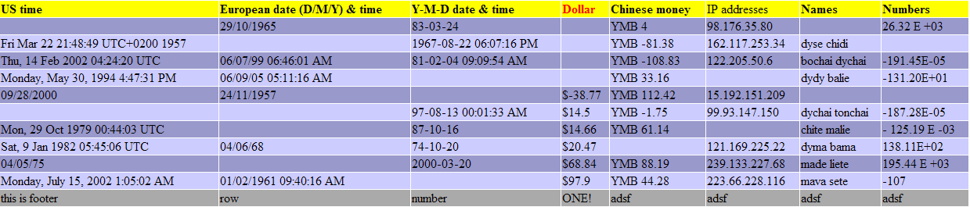
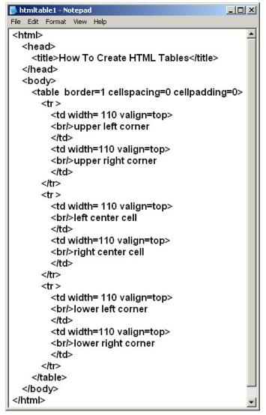
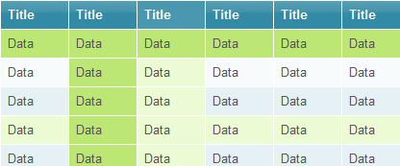
HTML Tables

Slide 5
HTML Tables
Tables represent tabular data
A table consists of one or several rows
Each row has one or more columns
Tables comprised of several core tags: <table></table>: begin / end the table <tr></tr>: create a table row <td></td>: create tabular data (cell)
Tables should not be used for layout. Use CSS floats and positioning styles instead

Slide 6
HTML Tables (2)
Start and end of a table
Start and end of a row
Start and end of a cell in a row
<table> ... </table>
<tr> ... </tr>
<td> ... </td>

Slide 7
Simple HTML Tables – Example
<table cellspacing="0" cellpadding="5">
<tr>
<td><img src="ppt.gif"></td>
<td><a href="lecture1.ppt">Lecture 1</a></td>
</tr>
<tr>
<td><img src="ppt.gif"></td>
<td><a href="lecture2.ppt">Lecture 2</a></td>
</tr>
<tr>
<td><img src="zip.gif"></td>
<td><a href="lecture2-demos.zip">
Lecture 2 - Demos</a></td>
</tr>
</table>

Slide 8
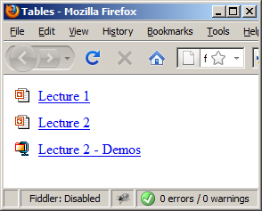
Simple HTML Tables – Example (2)
<table cellspacing="0" cellpadding="5">
<tr>
<td><img src="ppt.gif"></td>
<td><a href="lecture1.ppt">Lecture 1</a></td>
</tr>
<tr>
<td><img src="ppt.gif"></td>
<td><a href="lecture2.ppt">Lecture 2</a></td>
</tr>
<tr>
<td><img src="zip.gif"></td>
<td><a href="lecture2-demos.zip">
Lecture 2 - Demos</a></td>
</tr>
</table>

Slide 9

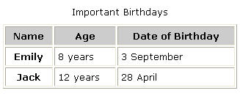

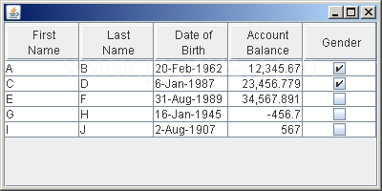
Simple HTML Tables
Live Demo

Slide 10
Complete HTML Tables
Table rows split into three semantic sections: header, body and footer
<thead> denotes table header and contains <th> elements, instead of <td> elements
<tbody> denotes collection of table rows that contain the very data
<tfoot> denotes table footer but comes BEFORE the <tbody> tag
<colgroup> and <col> define columns (most often used to set column widths)

Slide 11
Complete HTML Table: Example
<table>
<colgroup>
<col style="width:100px" /><col />
</colgroup>
<thead>
<tr><th>Column 1</th><th>Column 2</th></tr>
</thead>
<tfoot>
<tr><td>Footer 1</td><td>Footer 2</td></tr>
</tfoot>
<tbody>
<tr><td>Cell 1.1</td><td>Cell 1.2</td></tr>
<tr><td>Cell 2.1</td><td>Cell 2.2</td></tr>
</tbody>
</table>
columns
header
th
footer
Last comes the body (data)

Slide 12
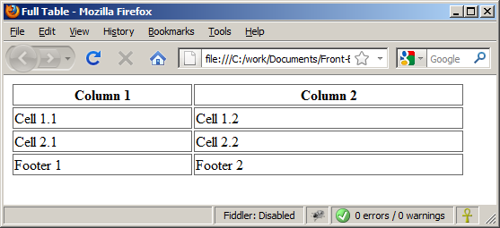
Complete HTML Table: Example (2)
By default, header text is bold and centered.
table-full.html
<table>
<colgroup>
<col style="width:200px" /><col />
</colgroup>
<thead>
<tr><th>Column 1</th><th>Column 2</th></tr>
</thead>
<tfoot>
<tr><td>Footer 1</td><td>Footer 2</td></tr>
</tfoot>
<tbody>
<tr><td>Cell 1.1</td><td>Cell 1.2</td></tr>
<tr><td>Cell 2.1</td><td>Cell 2.2</td></tr>
</tbody>
</table>
Although the footer is before the data in the code, it is displayed last

Slide 13
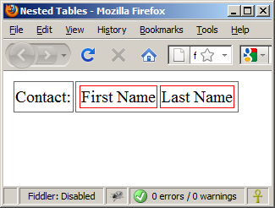
Nested Tables
Table data “cells” (<td>) can contain nested tables (tables within tables):
nested-tables.html
<table>
<tr>
<td>Contact:</td>
<td>
<table>
<tr>
<td>First Name</td>
<td>Last Name</td>
</tr>
</table>
</td>
</tr>
</table>

Slide 14

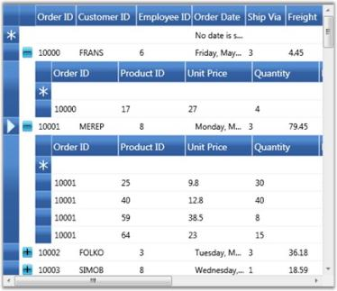
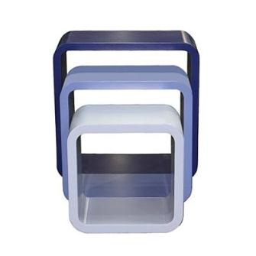
Nested Tables
Live Demo

Slide 15
Cell Spacing and Padding
Tables have two important attributes:
cellspacing
Defines the empty space between cells
cellpadding
Defines the empty space around the cell content
cell
cell
cell
cell
cell
cell
cell
cell

Slide 16
Cell Spacing and Padding – Example
table-cells.html
<html>
<head><title>Table Cells</title></head>
<body>
<table cellspacing="15" cellpadding="0">
<tr><td>First</td>
<td>Second</td></tr>
</table>
<br/>
<table cellspacing="0" cellpadding="10">
<tr><td>First</td><td>Second</td></tr>
</table>
</body>
</html>

Slide 17
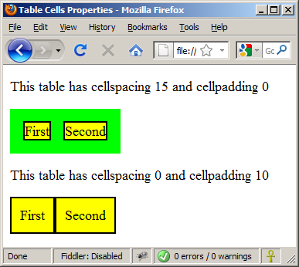
Cell Spacing and Padding – Example (2)
table-cells.html
<html>
<head><title>Table Cells</title></head>
<body>
<table cellspacing="15" cellpadding="0">
<tr><td>First</td>
<td>Second</td></tr>
</table>
<br/>
<table cellspacing="0" cellpadding="10">
<tr><td>First</td><td>Second</td></tr>
</table>
</body>
</html>

Slide 18
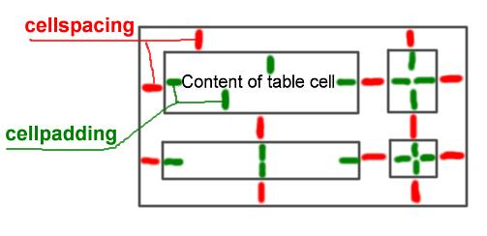
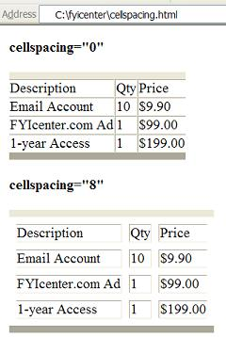
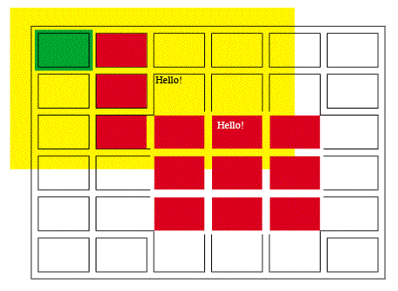
Table Cell Spacing and Cell Padding
Live Demo

Slide 19
Column and Row Span
Table cells have two important attributes:
colspan
Defines how many columns the cell occupies
rowspan
Defines how many rows the cell occupies
colspan="1"
colspan="1"
rowspan="2"
rowspan="1"
cell[1,1]
cell[1,2]
cell[1,1]
cell[1,2]
cell[2,1]
cell[2,1]
colspan="2"
rowspan="1"

Slide 20
Column and Row Span – Example
table-colspan-rowspan.html
<table cellspacing="0">
<tr class="1"><td>Cell[1,1]</td>
<td colspan="2">Cell[2,1]</td></tr>
<tr class=“2"><td>Cell[1,2]</td>
<td rowspan="2">Cell[2,2]</td>
<td>Cell[3,2]</td></tr>
<tr class=“3"><td>Cell[1,3]</td>
<td>Cell[2,3]</td></tr>
</table>

Slide 21
Column and Row Span – Example (2)
table-colspan-rowspan.html
<table cellspacing="0">
<tr class="1"><td>Cell[1,1]</td>
<td colspan="2">Cell[2,1]</td></tr>
<tr class=“2"><td>Cell[1,2]</td>
<td rowspan="2">Cell[2,2]</td>
<td>Cell[3,2]</td></tr>
<tr class=“3"><td>Cell[1,3]</td>
<td>Cell[2,3]</td></tr>
</table>
Cell[1,1]
Cell[2,1]
Cell[1,2]
Cell[2,2]
Cell[3,2]
Cell[1,3]
Cell[2,3]

Slide 22
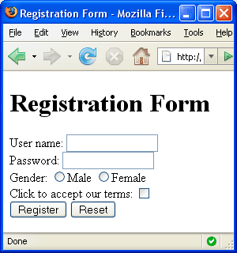


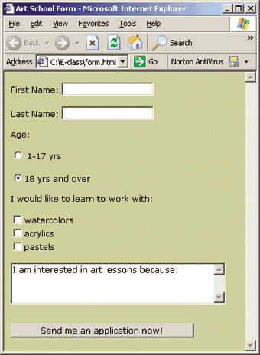
HTML Forms
Entering User Data from a Web Page

Slide 23
HTML Forms
Forms are the primary method for gathering data from site visitors
Create a form block with
Example:
The “method" attribute tells how the form data should be sent – via GET or POST request
<form></form>
<form name="myForm" method="post" action="path/to/some-script.php">
...
</form>
The "action" attribute tells where the form data should be sent

Slide 24
Form Fields
Single-line text input fields:
Multi-line textarea fields:
Hidden fields contain data not shown to the user:
Often used by JavaScript code
<input type="text" name="FirstName" value="This is a text field" />
<textarea name="Comments">This is a multi-line text field</textarea>
<input type="hidden" name="Account" value="This is a hidden text field" />

Slide 25
Fieldsets
Fieldsets are used to enclose a group of related form fields:
The <legend> is the fieldset's title.
<form method="post" action="form.aspx">
<fieldset>
<legend>Client Details</legend>
<input type="text" id="Name" />
<input type="text" id="Phone" />
</fieldset>
<fieldset>
<legend>Order Details</legend>
<input type="text" id="Quantity" />
<textarea cols="40" rows="10" id="Remarks"></textarea>
</fieldset>
</form>

Slide 26
Form Input Controls
Checkboxes:
Radio buttons:
Radio buttons can be grouped, allowing only one to be selected from a group:
<input type="checkbox" name="fruit" value="apple" />
<input type="radio" name="title" value="Mr." />
<input type="radio" name="city" value="Lom" />
<input type="radio" name="city" value="Ruse" />

Slide 27
Other Form Controls
Dropdown menus:
Submit button:
<select name="gender">
<option value="Value 1"
selected="selected">Male</option>
<option value="Value 2">Female</option>
<option value="Value 3">Other</option>
</select>
<input type="submit" name="submitBtn" value="Apply Now" />

Slide 28
Other Form Controls (2)
Reset button – brings the form to its initial state
Image button – acts like submit but image is displayed and click coordinates are sent
Ordinary button – used for Javascript, no default action
<input type="reset" name="resetBtn" value="Reset the form" />
<input type="image" src="submit.gif" name="submitBtn" alt="Submit" />
<input type="button" value="click me" />

Slide 29
Other Form Controls (3)
Password input – a text field which masks the entered text with * signs
Multiple select field – displays the list of items in multiple lines, instead of one
<input type="password" name="pass" />
<select name="products" multiple="multiple">
<option value="Value 1"
selected="selected">keyboard</option>
<option value="Value 2">mouse</option>
<option value="Value 3">speakers</option>
</select>

Slide 30
Other Form Controls (4)
File input – a field used for uploading files
When used, it requires the form element to have a specific attribute:
<input type="file" name="photo" />
<form enctype="multipart/form-data">
...
<input type="file" name="photo" />
...
</form>

Slide 31
Labels
Form labels are used to associate an explanatory text to a form field using the field's ID.
Clicking on a label focuses its associated field (checkboxes are toggled, radio buttons are checked)
Labels are both a usability and accessibility feature and are required in order to pass accessibility validation.
<label for="fn">First Name</label>
<input type="text" id="fn" />

Slide 32
HTML Forms – Example
form.html
<form method="post" action="apply-now.php">
<input name="subject" type="hidden" value="Class" />
<fieldset><legend>Academic information</legend>
<label for="degree">Degree</label>
<select name="degree" id="degree">
<option value="BA">Bachelor of Art</option>
<option value="BS">Bachelor of Science</option>
<option value="MBA" selected="selected">Master of
Business Administration</option>
</select>
<br />
<label for="studentid">Student ID</label>
<input type="password" name="studentid" />
</fieldset>
<fieldset><legend>Personal Details</legend>
<label for="fname">First Name</label>
<input type="text" name="fname" id="fname" />
<br />
<label for="lname">Last Name</label>
<input type="text" name="lname" id="lname" />

Slide 33
HTML Forms – Example (2)
form.html (continued)
<br />
Gender:
<input name="gender" type="radio" id="gm" value="m" />
<label for="gm">Male</label>
<input name="gender" type="radio" id="gf" value="f" />
<label for="gf">Female</label>
<br />
<label for="email">Email</label>
<input type="text" name="email" id="email" />
</fieldset>
<p>
<textarea name="terms" cols="30" rows="4"
readonly="readonly">TERMS AND CONDITIONS...</textarea>
</p>
<p>
<input type="submit" name="submit" value="Send Form" />
<input type="reset" value="Clear Form" />
</p>
</form>

Slide 34
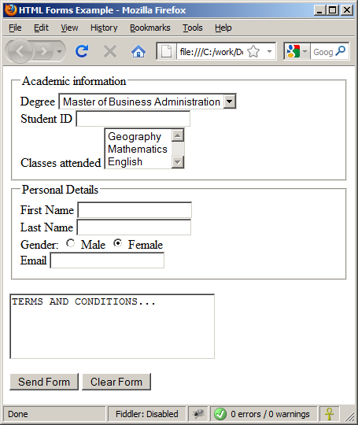
HTML Forms – Example (3)
form.html (continued)

Slide 35
TabIndex
The tabindex HTML attribute controls the order in which form fields and hyperlinks are focused when repeatedly pressing the TAB key
tabindex="0" (zero) - "natural" order
If X > Y, then elements with tabindex="X" are iterated before elements with tabindex="Y"
Elements with negative tabindex are skipped, however, this is not defined in the standard
<input type="text" tabindex="10" />

Slide 36
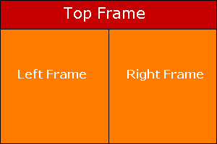
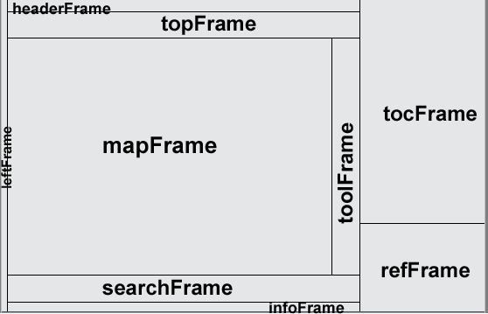
HTML Frames
<frameset>, <frame> and <iframe>

Slide 37
HTML Frames
Frames provide a way to show multiple HTML documents in a single Web page
The page can be split into separate views (frames) horizontally and vertically
Frames were popular in the early ages of HTML development, but now their usage is rejected
Frames are not supported by all user agents (browsers, search engines, etc.)
A <noframes> element is used to provide content for non-compatible agents.

Slide 38
HTML Frames – Demo
frames.html
<html>
<head><title>Frames Example</title></head>
<frameset cols="180px,*,150px">
<frame src="left.html" />
<frame src="middle.html" />
<frame src="right.html" />
</frameset>
</html>
Note the target attribute applied to the <a> elements in the left frame.

Slide 39
Inline Frames: <iframe>
Inline frames provide a way to show one website inside another website:
iframe-demo.html
<iframe name="iframeGoogle" width="600" height="400" src="http://www.google.com" frameborder="yes" scrolling="yes"></iframe>

Slide 40
HTML – Tables and Forms
?
?
?
?
?
Questions?
?
?
?
?
?
http://academy.telerik.com

Slide 41
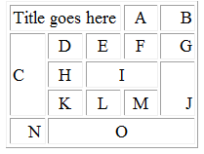
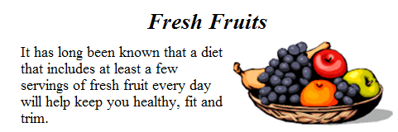
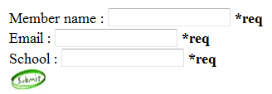
Homework
Create Web Pages like the following using tables:
Create a Web Page like the following using forms:

Slide 42
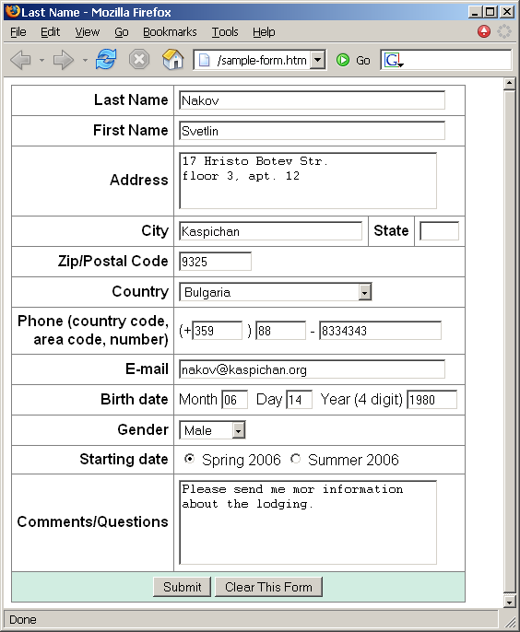
Homework (2)
Create a Web form that looks like this sample:
See the image Sample-form.png

